Slide 1
Amazon web services
Saurabh Kandhway

Slide 2
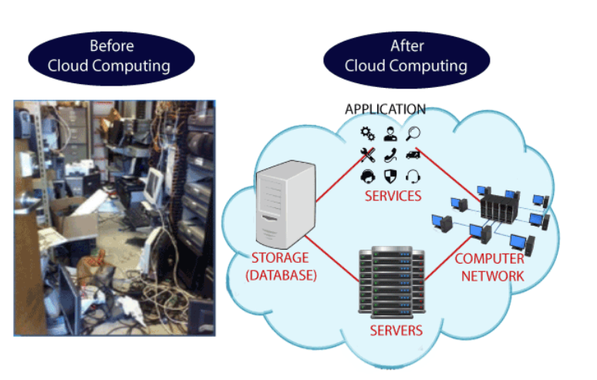
What is cloud computing
The term cloud refers to a network or the internet. It is a technology that uses remote servers on the internet to store, manage, and access data online rather than local drives. The data can be anything such as files, images, documents, audio, video, and more.
Developing new applications and services
Storage, back up, and recovery of data
Hosting blogs and websites
Delivery of software on demand
Analysis of data
Streaming videos and audios

Slide 3
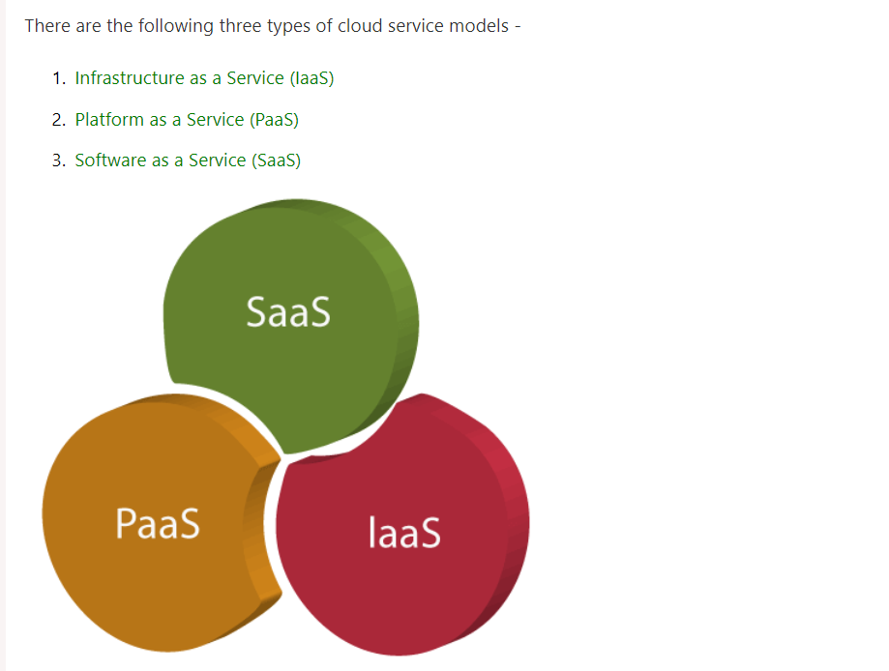
Cloud service models

Slide 4
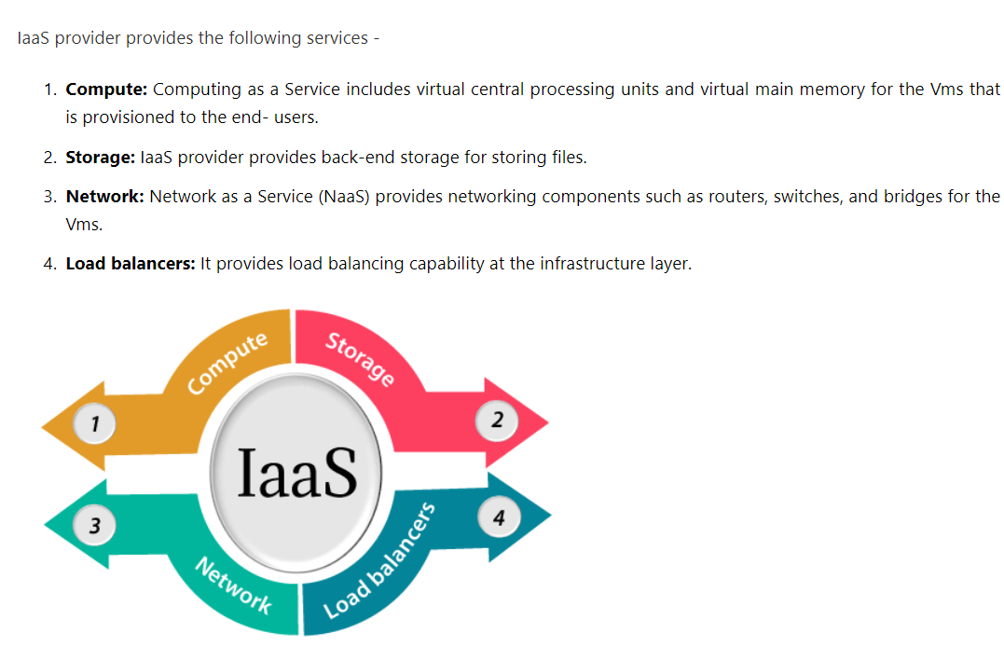
Iaas
Iaas is also known as Hardware as a Service (HaaS). It is one of the layers of the cloud computing platform. It allows customers to outsource their IT infrastructures such as servers, networking, processing, storage, virtual machines, and other resources. Customers access these resources on the Internet using a pay-as-per use model.

Slide 5
pAAs
Platform as a Service (PaaS) provides a runtime environment. It allows programmers to easily create, test, run, and deploy web applications. You can purchase these applications from a cloud service provider on a pay-as-per use basis and access them using the Internet connection. In PaaS, back end scalability is managed by the cloud service provider, so end- users do not need to worry about managing the infrastructure.
PaaS includes infrastructure (servers, storage, and networking) and platform (middleware, development tools, database management systems, business intelligence, and more) to support the web application life cycle.
Example: Google App Engine, Force.com, Joyent, Azure.
PaaS providers provide the Programming languages, Application frameworks, Databases, and Other tools:

Slide 6
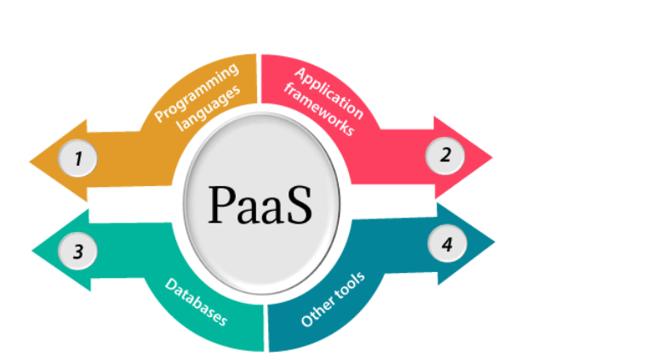
Paas (continued)

Slide 7
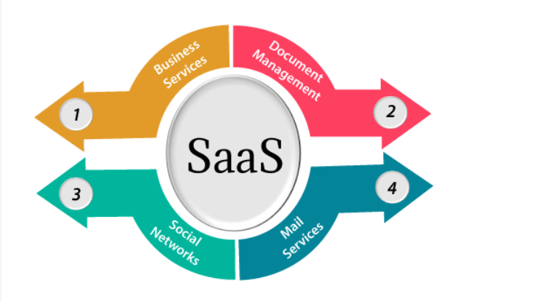
saas
SaaS is also known as "On-Demand Software". It is a software distribution model in which services are hosted by a cloud service provider. These services are available to end-users over the internet so, the end-users do not need to install any software on their devices to access these services.

Slide 8
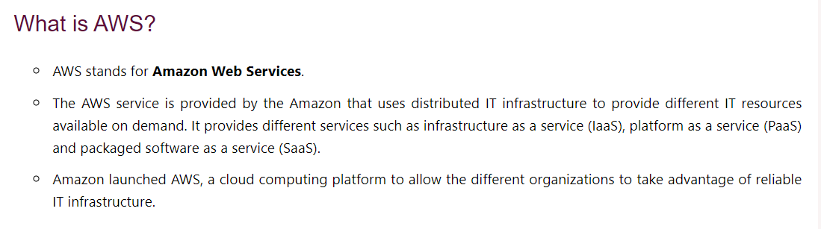
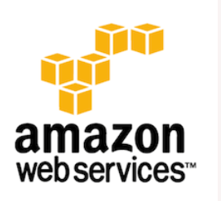
What is aws

Slide 9
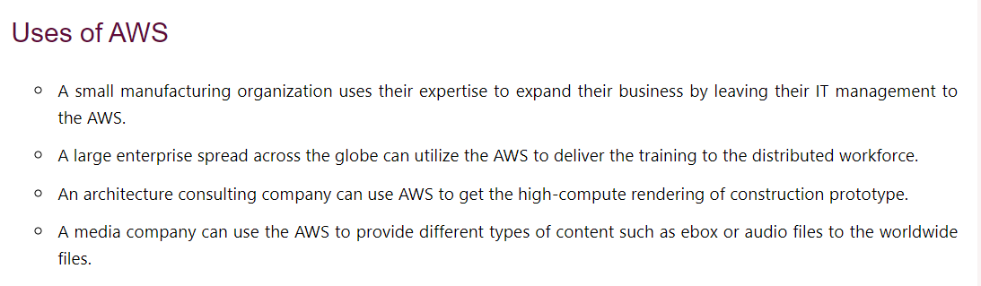
Uses of aws

Slide 10
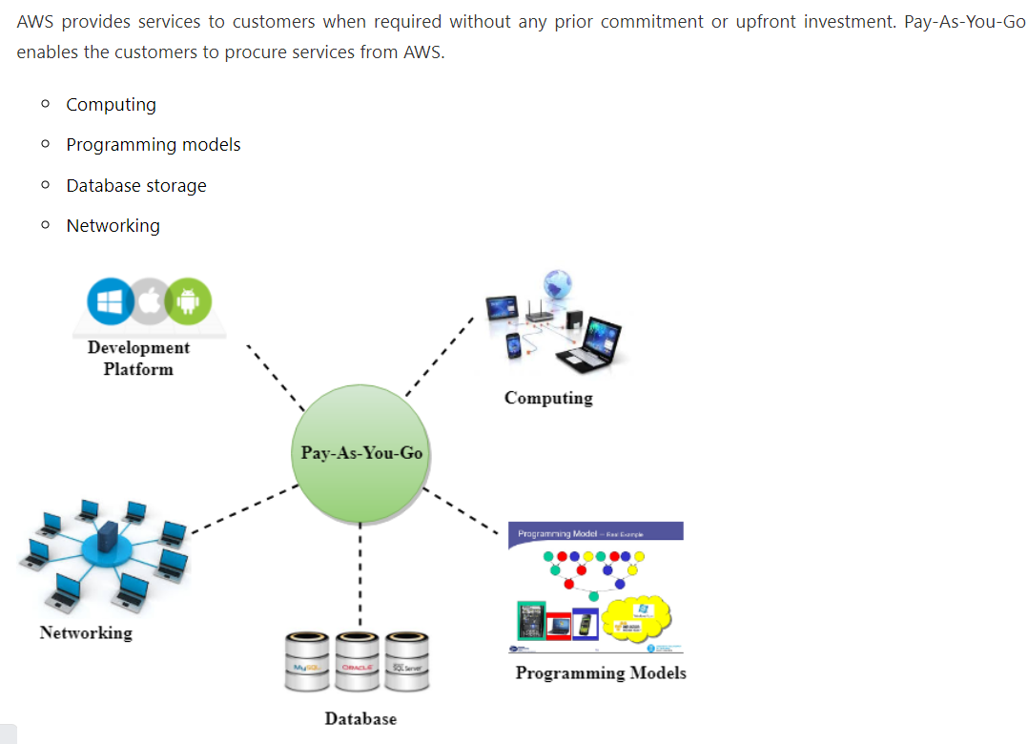
Pay as you go model

Slide 11
Advantages of aws
1) Flexibility
We can get more time for core business tasks due to the instant availability of new features and services in AWS.
2) Cost-effectiveness
AWS requires no upfront investment, long-term commitment, and minimum expense when compared to traditional IT infrastructure that requires a huge investment.
3) Scalability/Elasticity
Through AWS, autoscaling and elastic load balancing techniques are automatically scaled up or down, when demand increases or decreases respectively
4) Security
AWS provides end-to-end security and privacy to customers.

Slide 12
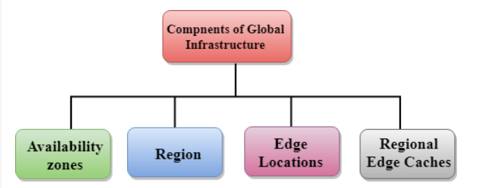
Aws global infrastructure
AWS is a cloud computing platform which is globally available.
Global infrastructure is a region around the world in which AWS is based. Global infrastructure is a bunch of high-level IT services which is shown below:
AWS is available in 19 regions, and 57 availability zones in December 2018 and 5 more regions 15 more availability zones for 2019.

Slide 13
Availability zone as a Data Center
An availability zone is a facility that can be somewhere in a country or in a city. Inside this facility, i.e., Data Centre, we can have multiple servers, switches, load balancing, firewalls. The things which interact with the cloud sits inside the data centers.
An availability zone can be a several data centers, but if they are close together, they are counted as 1 availability zone.

Slide 14
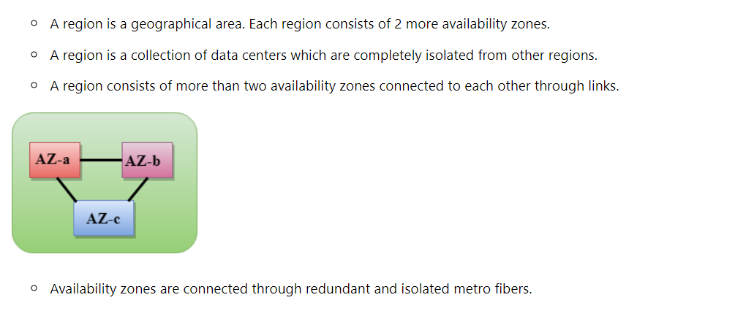
Aws regions

Slide 15
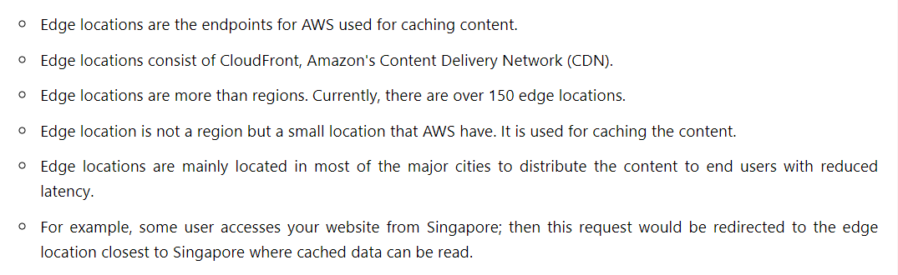
Edge locations

Slide 16
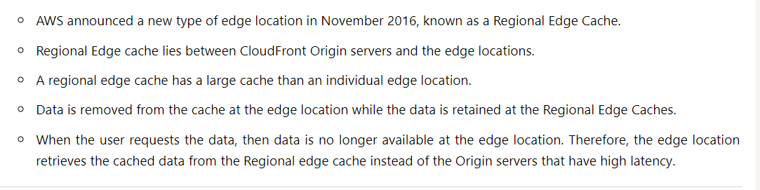
Regional edge caches

